Slide 1
Exemplar Management Tool Release 3
Team 04
Kevin Schütz, Valentina Hummenberger, Julia Hammer,
Praktikum Software Engineering - SS 2021

Slide 2
Presentation Release 3 - Agenda
Current Status with demonstration of the prototype
Analysis of code quality with PMD, Findbugs, etc.
First Version of project documentation Prototype Demonstration
Unit Tests
Plan for Final Release

Slide 3
current status
We implemented alle requirements except the optional most accessed exemplars requirement

Slide 4
Prototype
We would like to present our Exemplar Management Tool

Slide 5
Analysis of code quality with PMD, Findbugs, etc.
Kevin
First Version of project documentation Prototype Demonstration
Julia

Slide 6
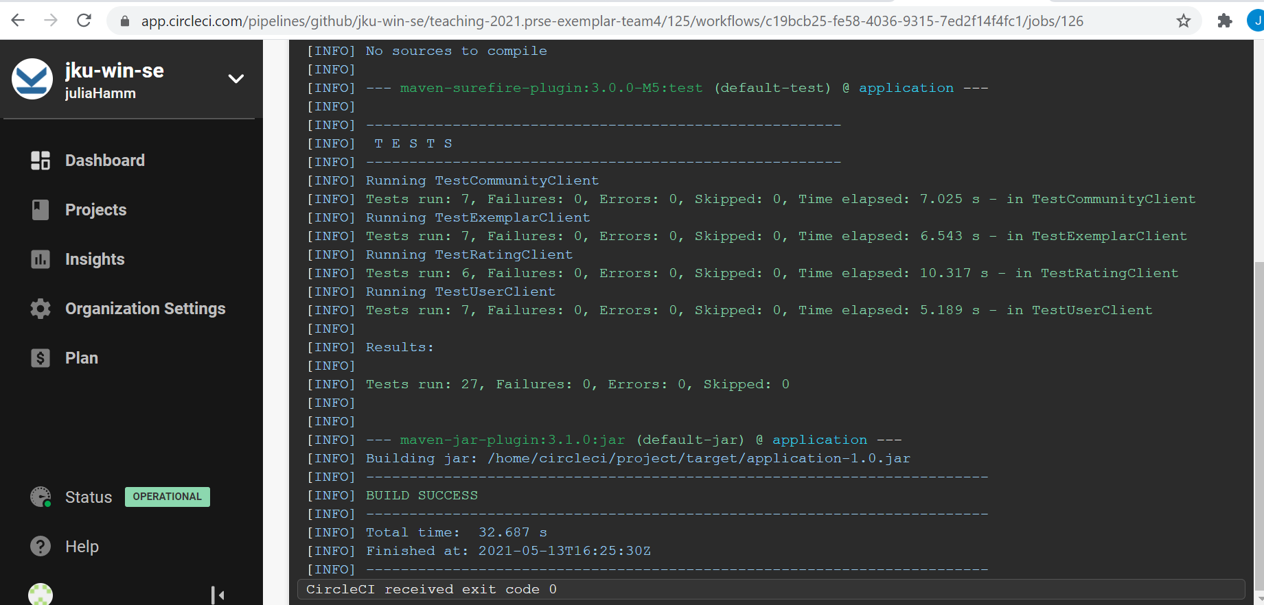

Unit Tests

Slide 7
Current Status (Redmine)+ Progress in Release 3
For the tasks we implemented, we would like to point to zenhub
We did calculate the effort it would take us to implement the tasks accurately. In comparison to Release 2, we would conclude, that our time measuring skills expanded.

Slide 8
Problems in Release 3

Slide 9
Next steps+ Planing of Final Release
Unit Tests
Enhance Documentation

